Slide 1

DDOS DETECTION BY
ENTROPY CALCULATION
BY
HARSHITH KUMAR A

Slide 2
CONTENTS
01
Introduction
02
Model
03
Implementation
04
Result

Slide 3
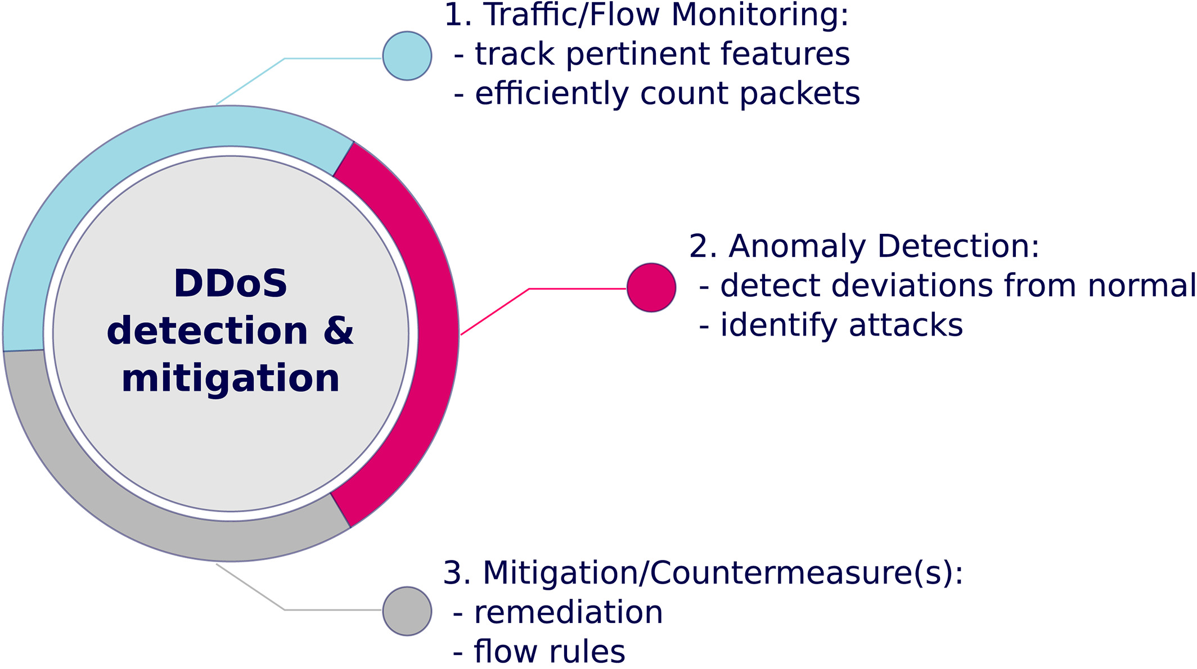
INTRODUCION
INTRODUCTION
DDOS DETECTION
Entropy calculation, a method for DDoS detection in SDN, is conducted by traffic features from the switches.
Calculating the entropy measure randomness in the packets that are coming to a network.
The higher the randomness, the higher is the entropy and vice versa.
By setting a threshold, if the entropy passes it or below it,depending on the scheme, an attack is detected.
2.Attack detection
DDOS detection

Slide 4
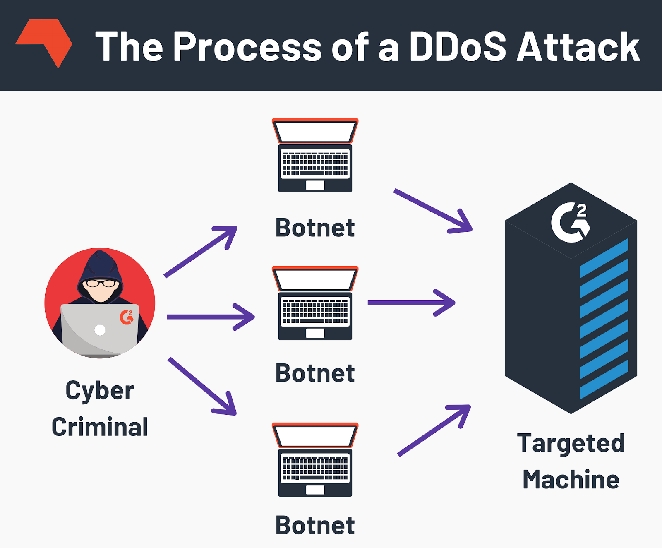
DDOS ATTACK
DDOS
What is a DDoS attack?
In Denial-of-Service (DoS) attack attacker seeks to make network resource unavailable to intended users .
This is typically accomplished by flooding the target
with superfluous requests in an attempt to overload
the system.

Slide 5
Important Terminologies
TERMINOLOGIES
Software-defined networking is an approach to network management that enables dynamic,programmatically efficient network configuration in order to improve network performance and monitoring.
SDN Controller
Mininet is open source software that is used to simulate a software defined network (SDN) and its compatible controllers, switches and hosts.
MININET
POX is a Python based open source OpenFlow or Software Defined Networking (SDN) Controller. POX is used for faster development and prototyping of new network applications.
POX Controller

Slide 6
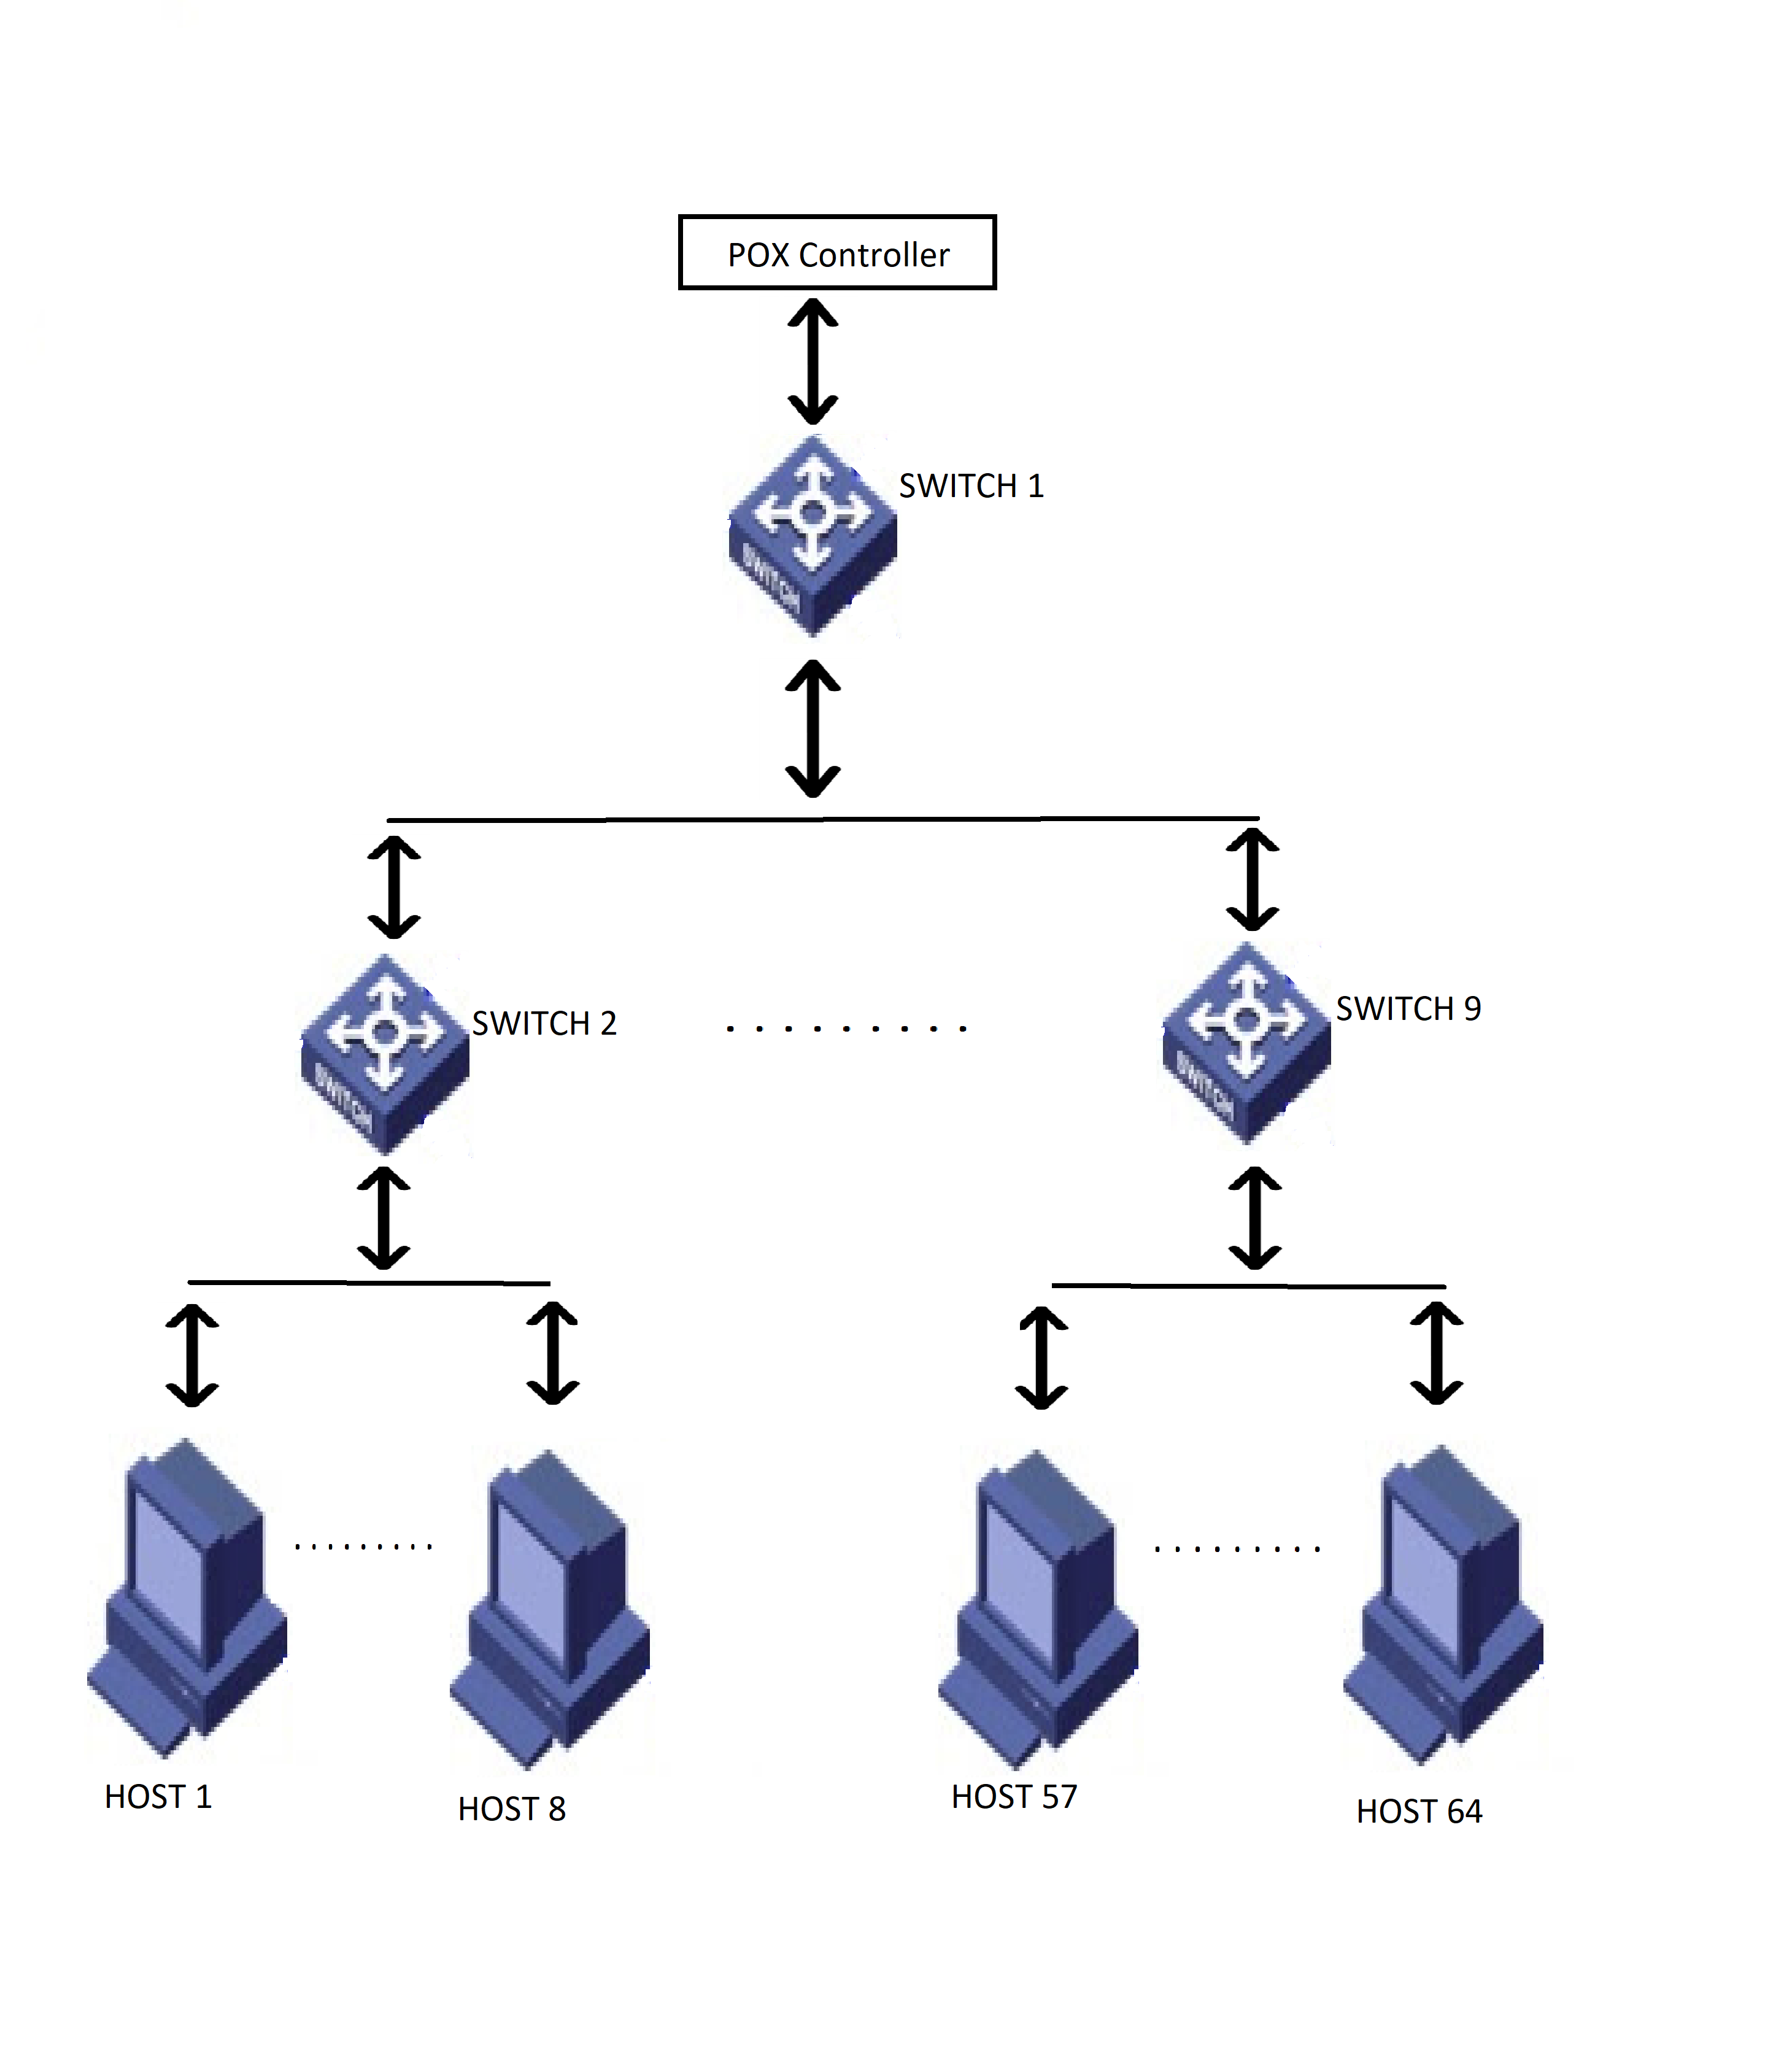
Topology Used
TOPOLOGY

Slide 7
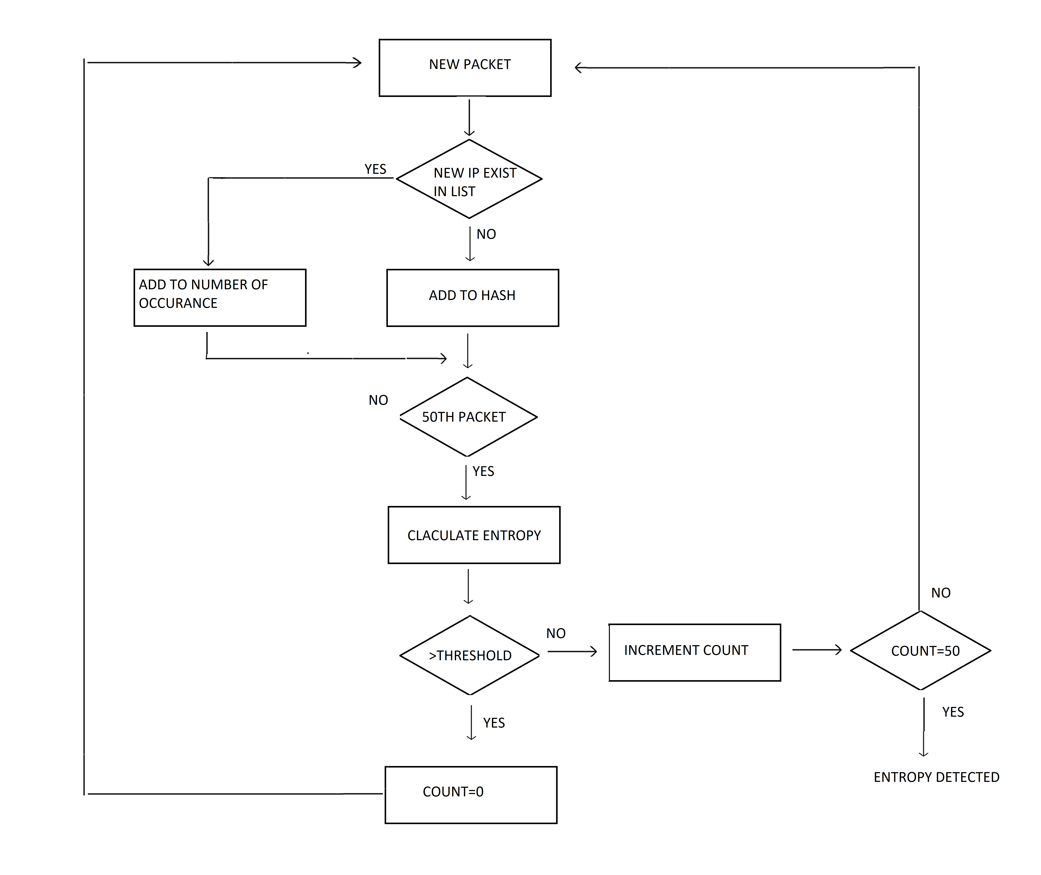
MODEL
Algorithm

Slide 8
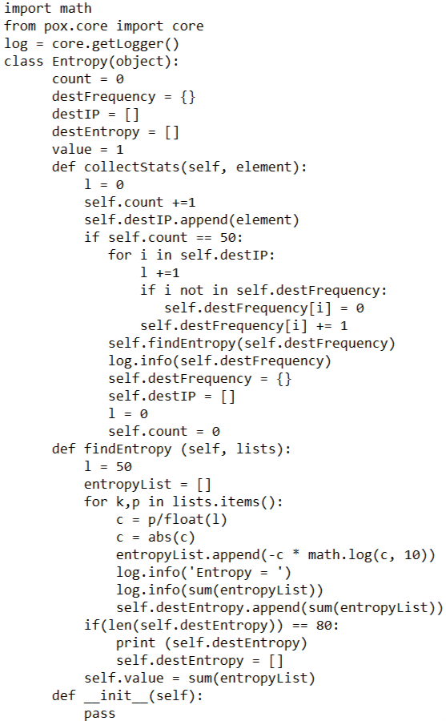
DETECTION CODE
CODE

First, make a count of 50 packets in a window and then calculate the entropy and compare it with threshold and make a count of consecutive entropy value lower than threshold. If this count reaches 5 then DDoS had occurred otherwise not.

Slide 9
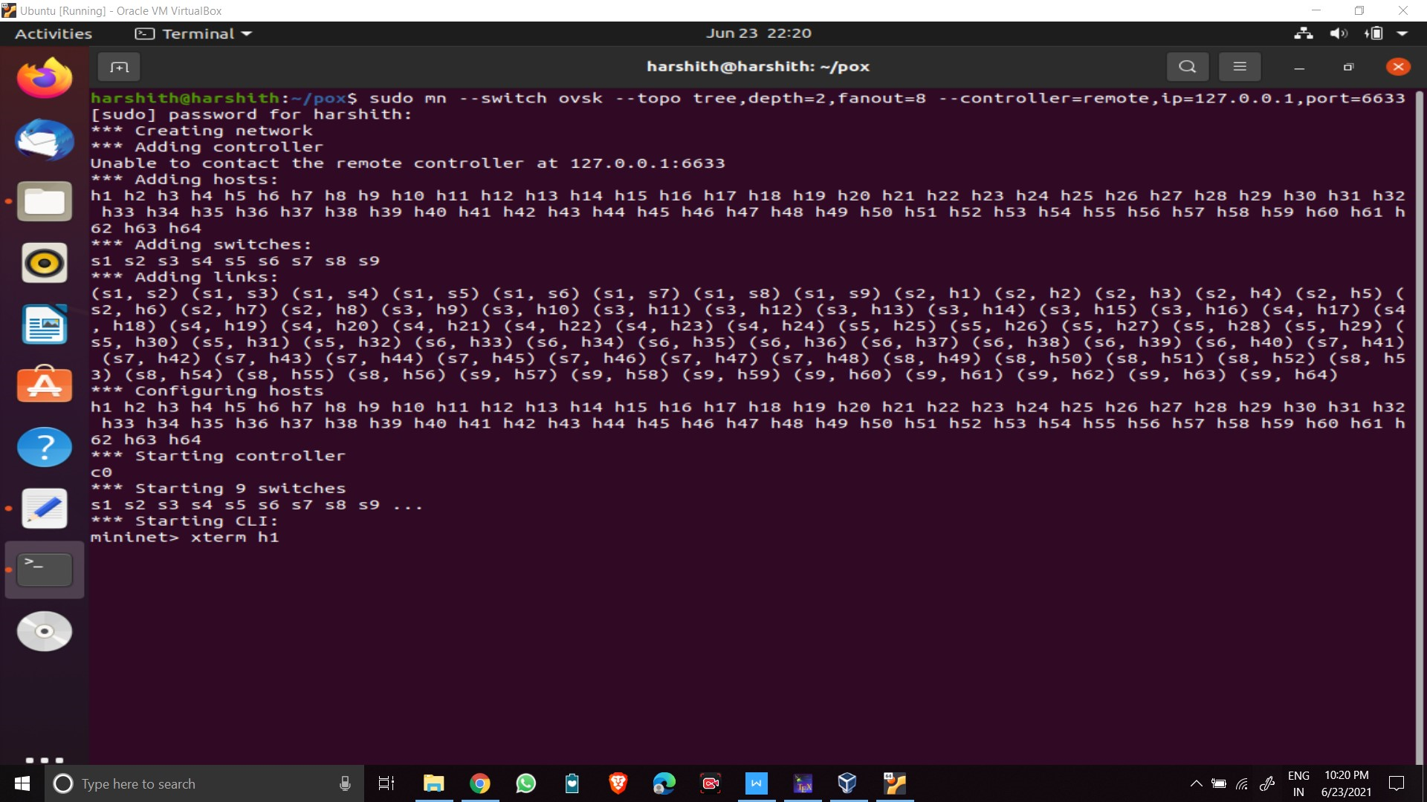
Implementation
IMPLEMENTATION
Creating topology in mininet
Creating tree topology which consisted of 9 switches and 64 hosts using mininet.usning the command

Slide 10
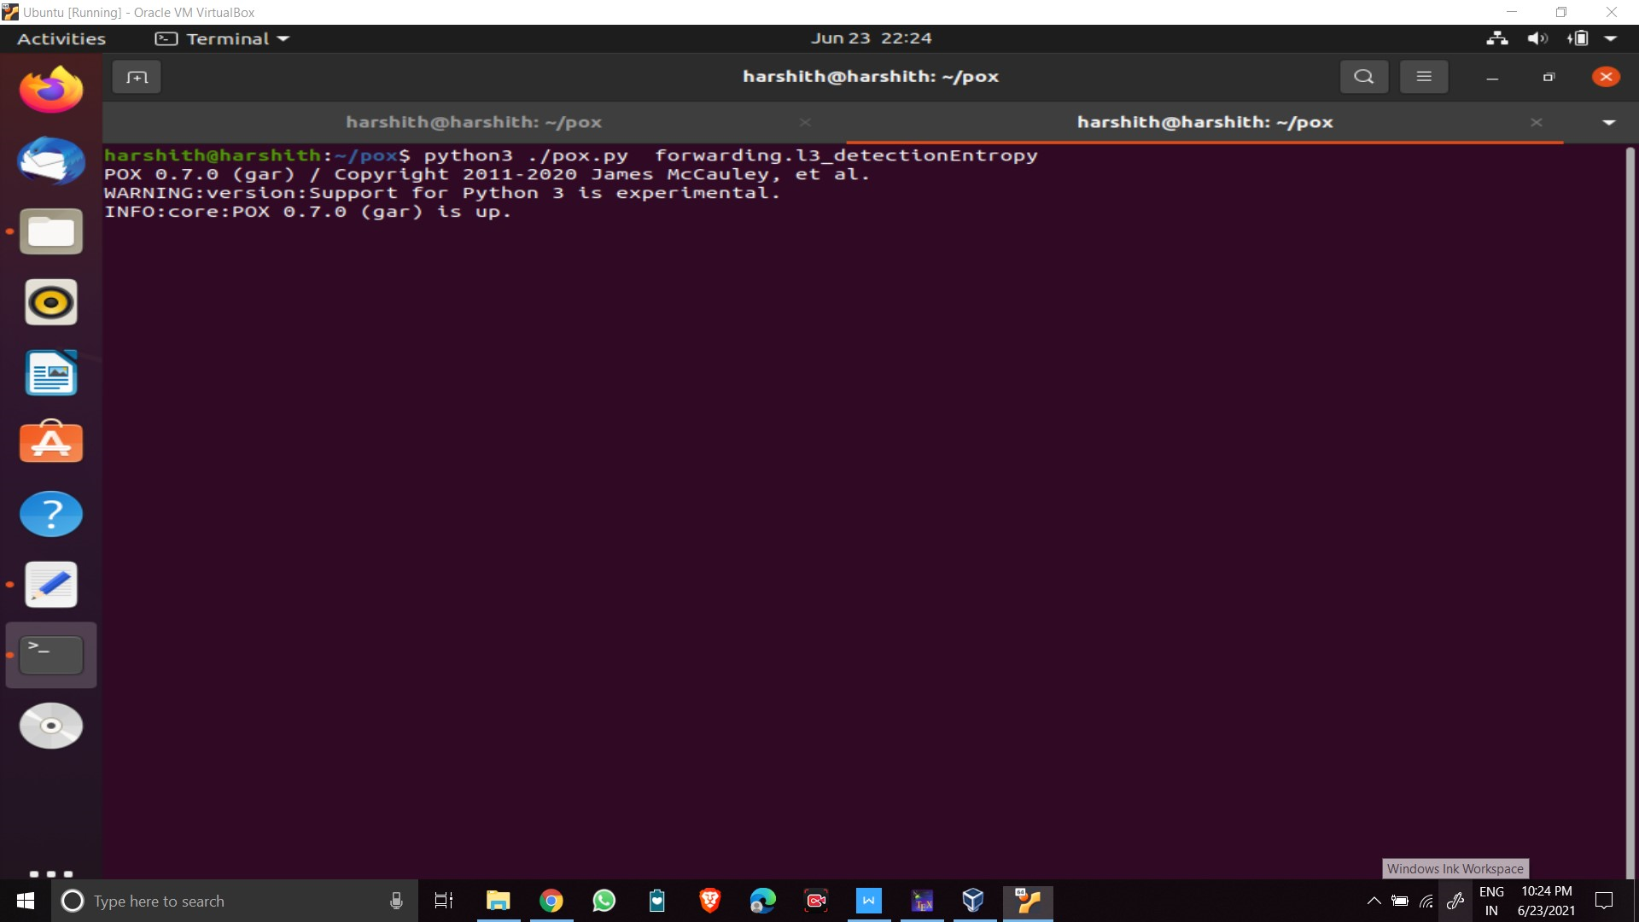
Implementation
IMPLEMENTATION
Simultaneously, In the Mininet terminal of Virtual Box enter the following command to run the pox controller:
Starting pox controller

Slide 11
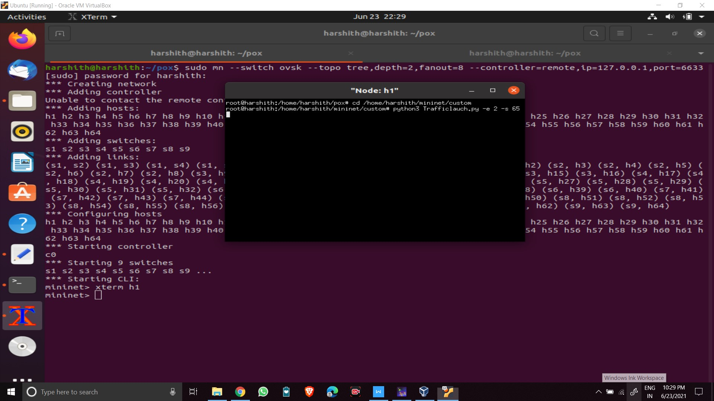
Implementation
IMPLEMENTATION
Run the traffic generation script from one of the host which generates random source IP and send the packets to random destinations. Observe the entropy in POX controller terminal.
Traffic launch

Slide 12
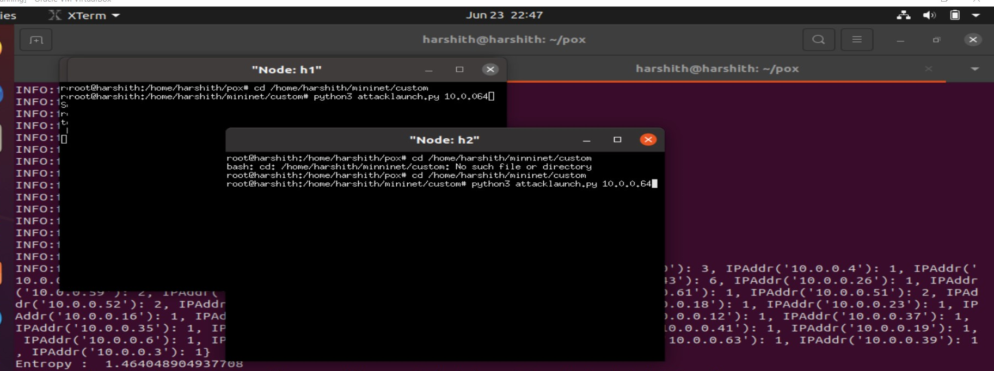
Implementation
IMPLEMENTATION
Now repeat above step on h1 and parallelly enter the following command to run the attack traffic from h4 and h6 xterm windows to attack on h56. python launchAttack.py 10.0.0.5
Attack launch

Slide 13
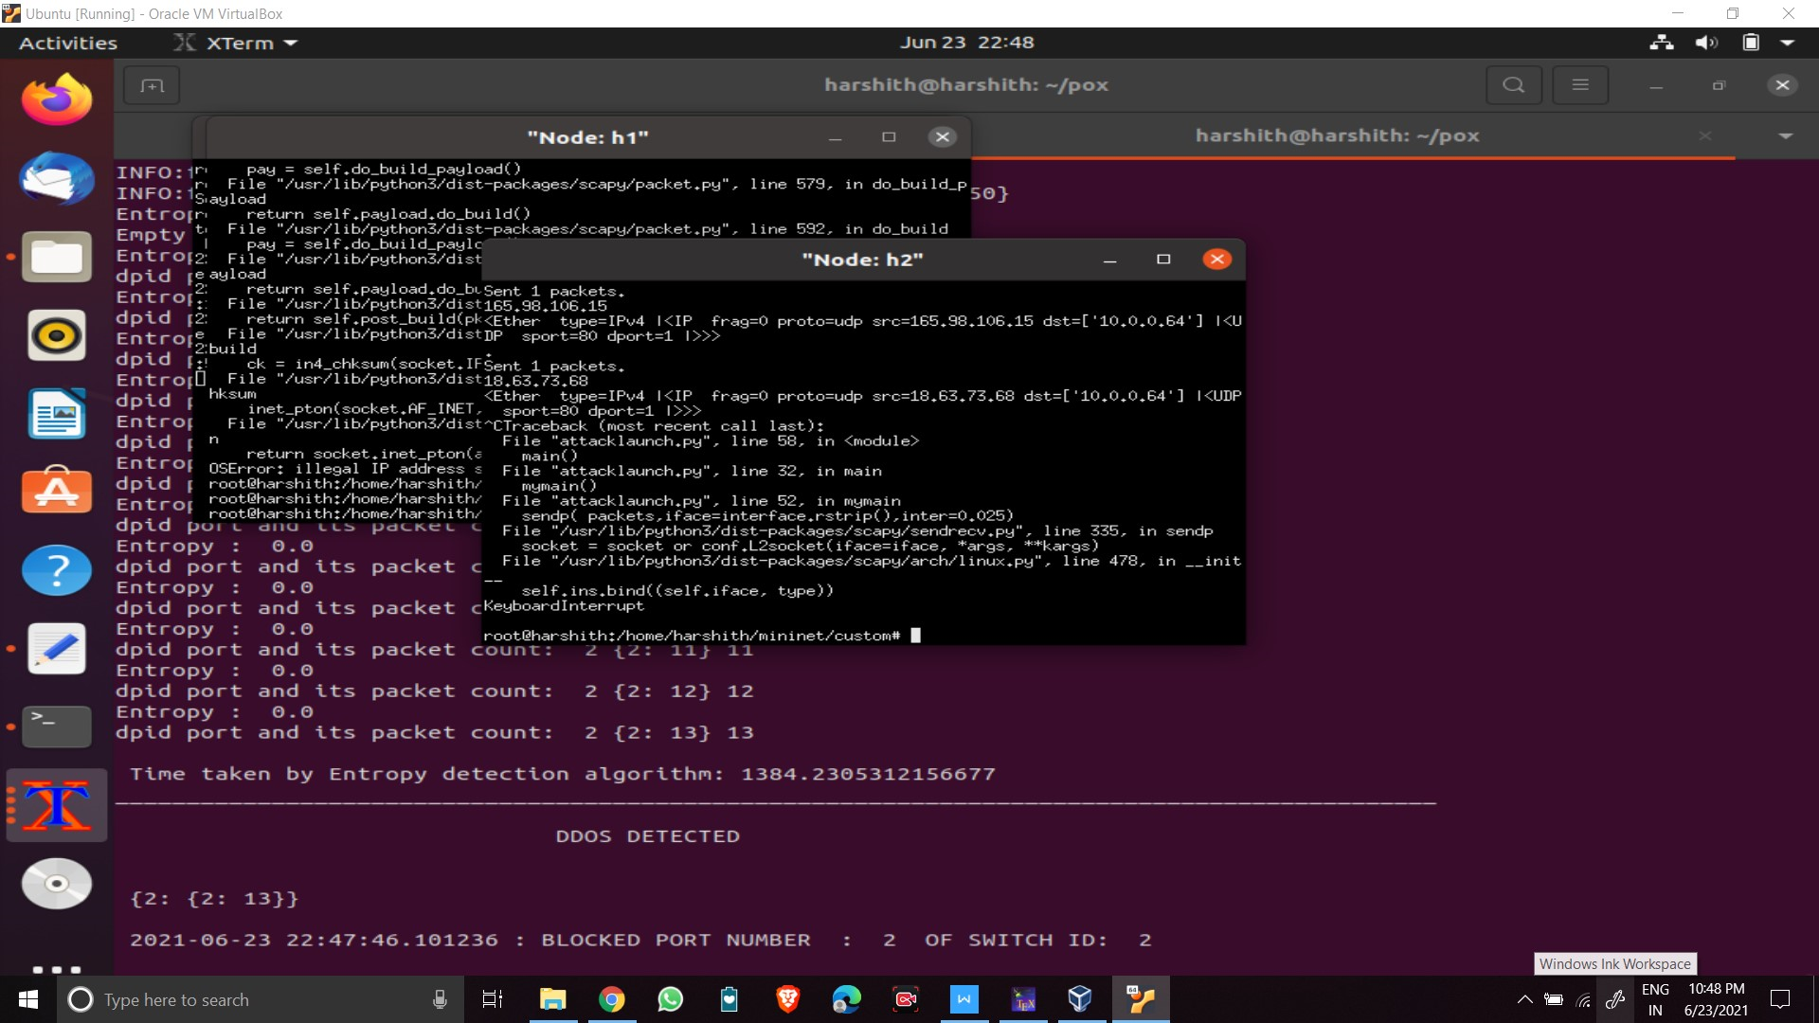
Implementation
IMPLEMENTATION
Observing the entropy values in the POX controller. The value decreases below the threshold value (which is equal to 0.5 here) for normal traffic.
Entropy value after ddos attack

Slide 14
Result
Result
SDN Controller
We have implemented a method to detect DDoS attacks successfully.
Here , every packet which has entropy value less than the threshold value, is stored in a dictionary and if an entry comes more than 5 times, it is assumed as a DDoS attack.
As a result of the experiment, Entropy calculation for DDoS detection turns out to be a effective solution for the detection of anomaly in network traffic in a SDN architecture. This can be a efficient method to adopt at software defined data centers.
MININET
POX Controller

Slide 15
THANK YOU

